Slide 1
Readmission Model Overview
Goal:
Build model with better performance than current industry standards like LACE and HOSPITAL.
Predict not only which members are at risk of being readmitted, but also the potential causes of readmission
Deliver the predictions in near real-time in an automated, easy-to-understand tool.
Impact:
Moving from reactive to proactive readmissions prevention.
Star rating and medical measure improvement
Medical cost saving
readmission reduction
more planned office visits and fewer ER visits after days of discharge.

Slide 2
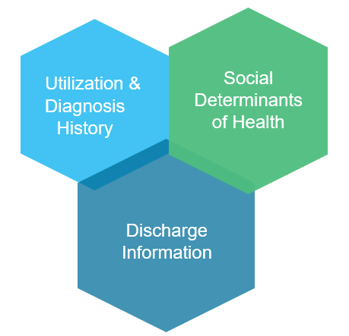
Readmission Model Overview Risk Variables
Discharge Information
Utilization/ Diagnosis
Social Determinants of Health
Length of Stay
Discharge Status
Discharge location
Post-discharge office visit planning
Discharge DRG
# of Visits
# of ED Visits
# of Inpatient Visits
# of Office Visits
# of Medications
# of Chronic Conditions
Chronic Conditions Flag: e.g. Anxiety, Cardiovascular Disease, CKD, Dementia, Depression, Diabetes, Heart Failure, Hypertension, Mood Disorder, Obesity, Pain, Mental Disability
Age
Insurance Type
BMI
Access to Food, Transportation…
Marital Status
Race
Housing Status
Sexually Active
Tobacco Use
Illegal Drug Use
Loneliness
Key Feature Engineering Questions:
Factors that are the strongest predictors of hospital readmission
How well can we predict hospital readmission with limited features.
When considered along with clinical data (discharge information, utilization, diagnoses, utilization etc.), are SDoH in their current form significant predictors of readmission risk?

Slide 3
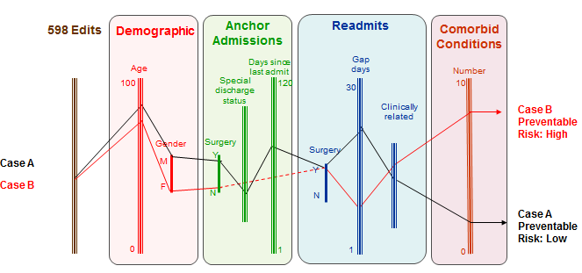
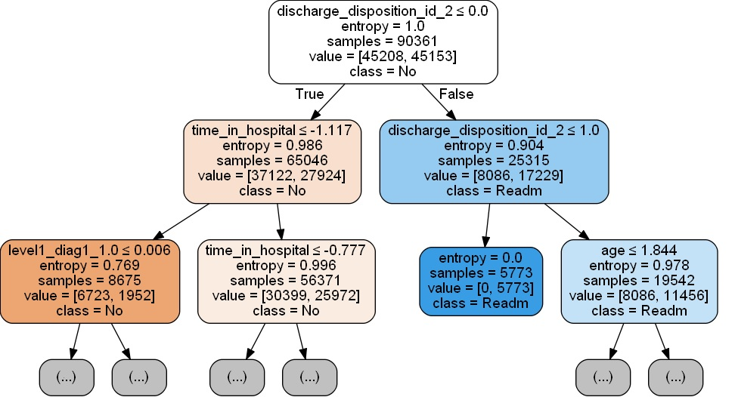
Readmission Model Overview Readmission Predictive Model
Logistic Regression Model
Radom Forest Model
1
2
↑ operational savings by prioritizing cases with high risk of denial
↓ effort to review claims that ultimately gets approved
↓ cases medical records request
1
Tree-based Model:
By iteratively and hierarchically observing the level of certainty, tree-based model can help us find the relative importance of different factors using a more human-like decision making strategy in establishing this determination.
Random forest models consider more than one decision tree and then doing a majority voting, thus is more robust predictive representations
2
3
Logistic regression:
Interpretability & Accuracy
Help us understand the relative impact and statistical significance of each factor on the probability of readmission

Slide 4
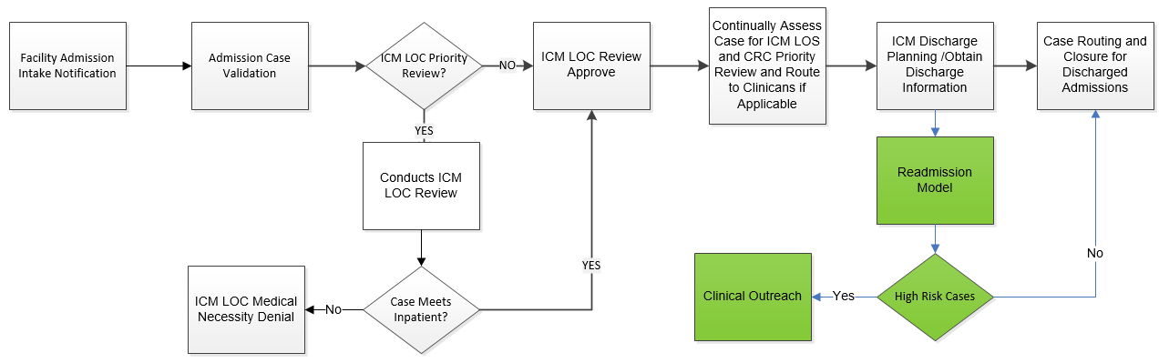
Readmission Model Overview Model Deployment
Benefit of deploying readmission perdition model alongside ICM’s discharge planning review in ICUE .
readmission risk can be calculated right after the discharge, with both historical claims and discharge information available for more accurate risk scoring.
real-time run model will be able identify the members with a high probability of readmission and direct them to the appropriate clinical teams for immediate intervention.

Slide 5
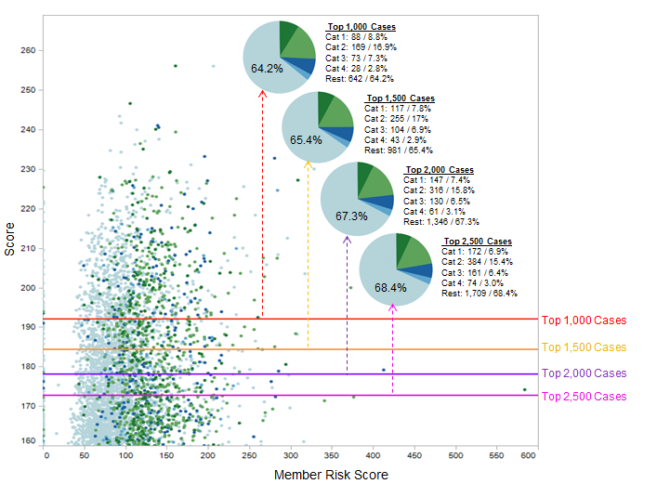
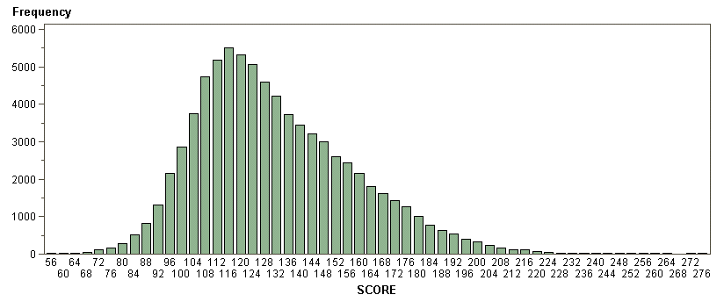
Readmission Model Overview Model Deployment (2)
Whole population
High Risk Cases
Opportunity:
Stratification examples: top 1,000/1,500/2,000/2,500 cases
Select the cut off scores.
Understand the characteristics of high-risk cases by analyzing the top predictors :
Gain insight on how the top predictors impact the scoring results
Insure reasonable results, clinically and analytically

Slide 6
Readmission Model Overview Challenges
Data Availability
Access to demographic and attitudinal information about readmissions in members, which is a comprehensive but not an exhaustive account of all the factors that may affect hospital readmissions.
Limited access to SDoH features such as access to care, which has been shown in one study to account for 58% of variation readmission rates.
Readmission Model Limits
Readmission model turn to have high specification, i.e. low false positive rate
Considering UHG have already have readmission intervention care team, training data might be biased.
If we successfully prevent high-risk patients from readmitting consistently, theoretically, patients with similar profiles would not be high-risk in future models.

